Slide 1
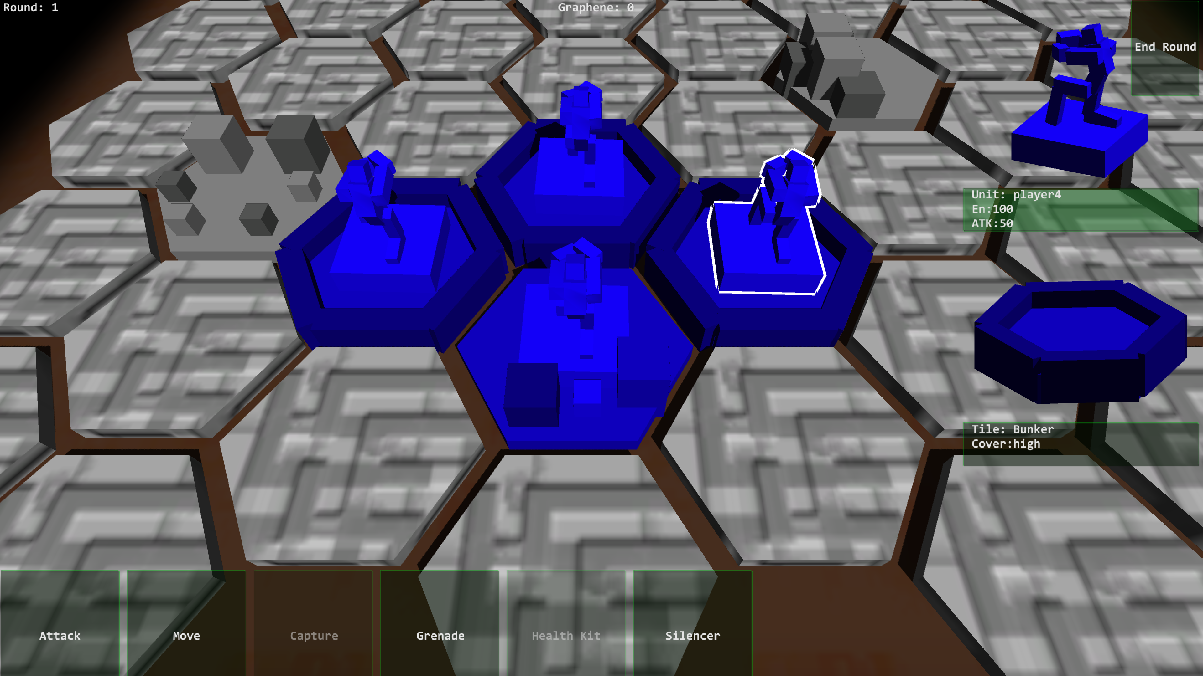

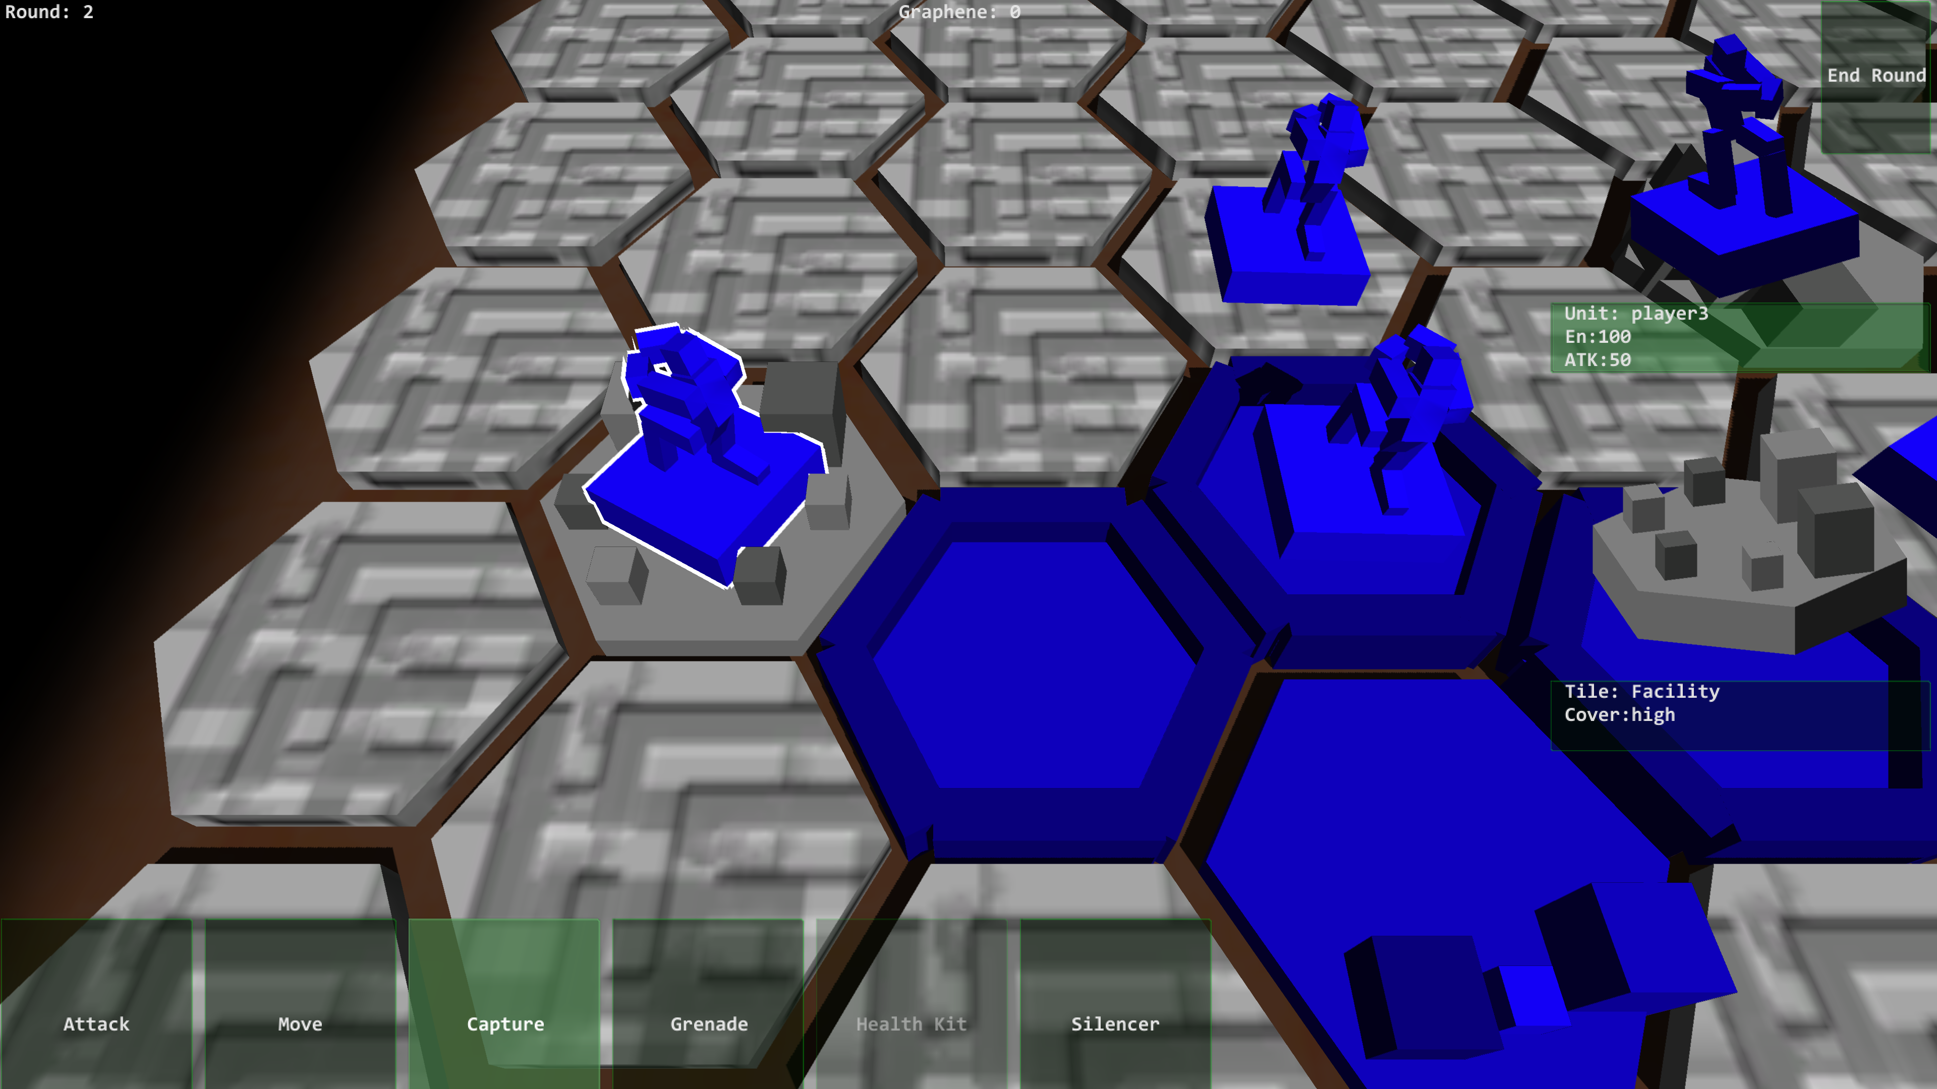
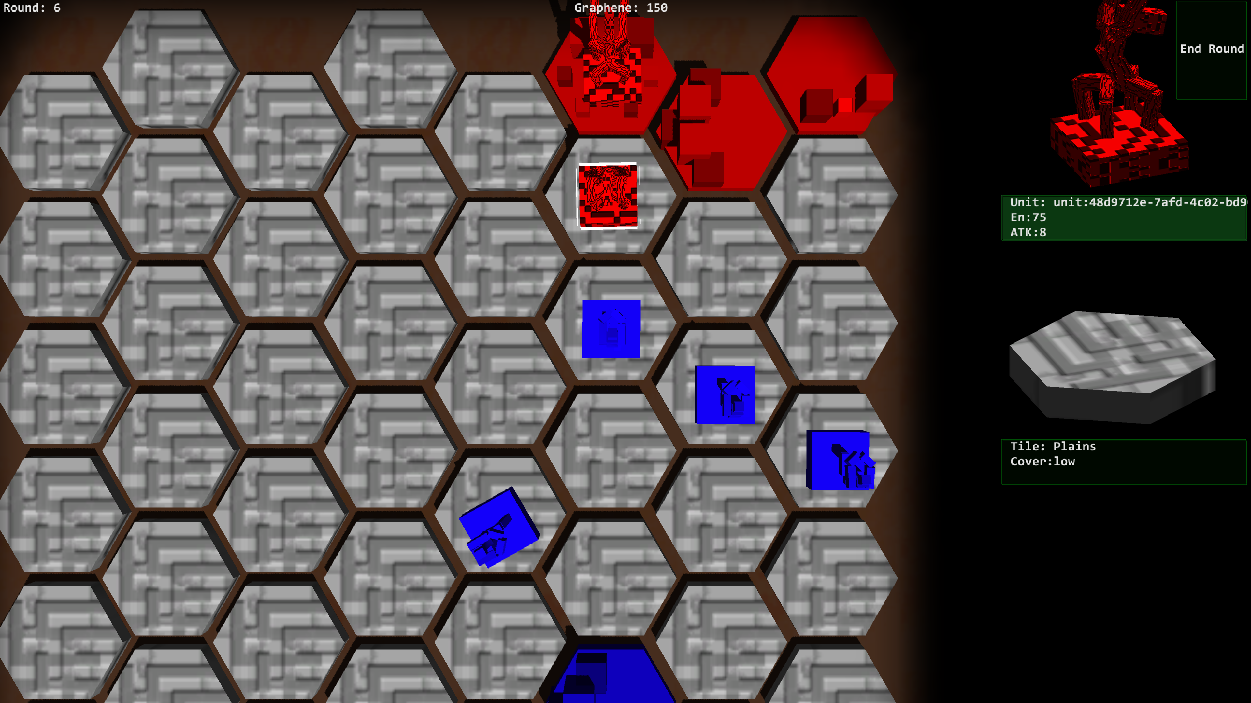
Resist and Reconquer
Resist and Reconquer is a game about defending a city from mutants.
Tactical movement on hex grids.
Versatile units who battle, sneak and capture.
Noise system which directs the enemy AI.
http://youtu.be/3Mdbf4WZJlg
RoundB. Strategy
PC/Mobile
Dez. 2014
12+
Omar Ajerray
PC: $8.99; Mob: $3.99
Notes:
Comments
This is the most important slide in the presentation!
The 3-5 core design features should be catchy, but also used as key product design drivers used in the pre-production.
The one-sentence description should be informative and catchy.
Good graphics is key.

